Slide 1



DATA SCIENCE PROJECT

Slide 2
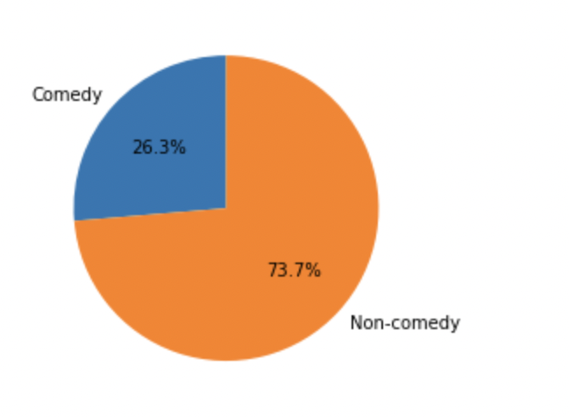
Project Objective:
To develop a predictive model that can predict whether a movie is a Comedy.
Data Description:
movie_story_student_file : contains the movie stories.
movies : This file contain the movie genres.
movie_story_evaluation_file : data to be used after developing and selecting the best model to check if the model predicts the movie as Comedy or not.

Slide 3

Data Preprocessing
Converting to lower case: To make sure that the model doesn't confuse with same words written in different case, we convert all text data to lower case.
Removing Special characters: punctuations do not help in our analysis and hence they are removed.
Removing Stop words: Words that repeat too frequently don’t add value to the model and would confuse it, hence it is good to be removed.

Slide 4
Text Analysis
Stemming - method of normalization of word by its root - We use only ‘PorterStemmer’ from the entire NLTk stem module.
Lemmatizing - is the algorithmic process of finding the lemma of a word depending on its meaning and context
TFIDF

Slide 5
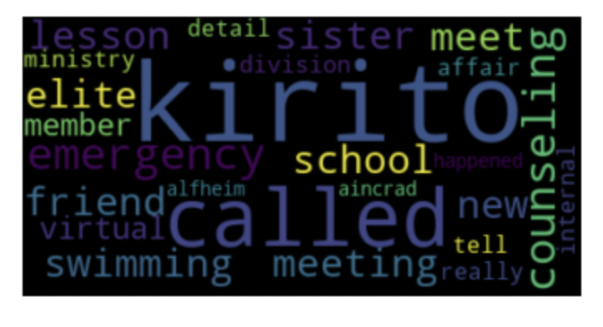
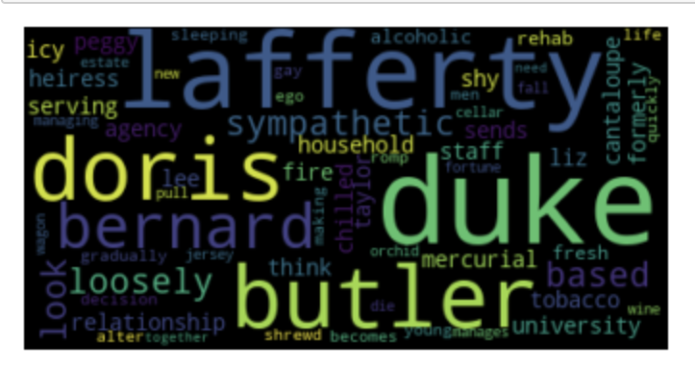
Visualization
Visualization here is done using Word Cloud library.
Here the story column of new movies data set is used after performing text analysis and preprocessing
Visualize most commonword when the movie is of comedy genre.

Slide 6
Data prediction Models Used
Logistic Regression
Random Forest Classifier
MLP Classifier
SVC
Decision Tree Classifier

Slide 7
Interpretation of Results
 | Accuracy | Precision | Recall | F1-Score
Logistic Regression | 78.5 | 75 | 28 | 40
Random Forest Classifier | 77.1 | 73 | 21 | 32
MLP Classifier | 72.4 | 44 | 37 | 40
SVC | 75.24 | 57 | 5 | 8
Decision Tree Classifier | 70 | 44 | 41 | 43
*All values are in %. **The above values are for true positive scenario.

